Slide 1
CERT Educational Series
Greg Monty PhD, Vicki Foust PhD, and Elizabeth Keele M.Ed
Heat Transfer Enrichment II,
Heat Equation, Weather Impacts

Slide 2
Heat Equation development
If you have a material, and you wish to know how much heat will be needed to change that materials temperature,
What factors do you need to know to calculate the heat needed?
Let’s take a closer look…

Slide 3
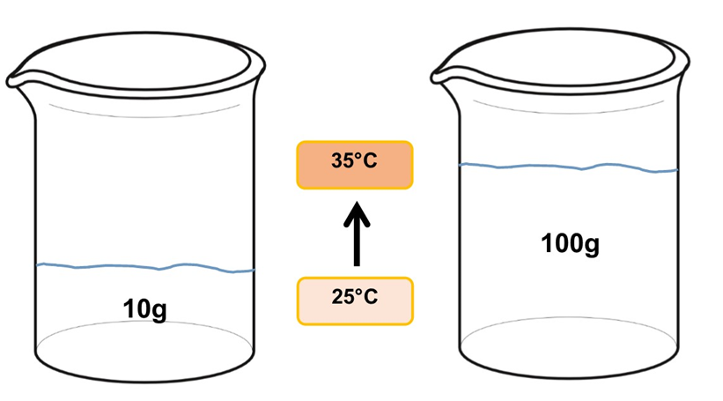
Mass of Material
Will different masses of water require
different amounts of heat energy to change their temperature the same amount?
HEAT depends on Mass of Material

Slide 4
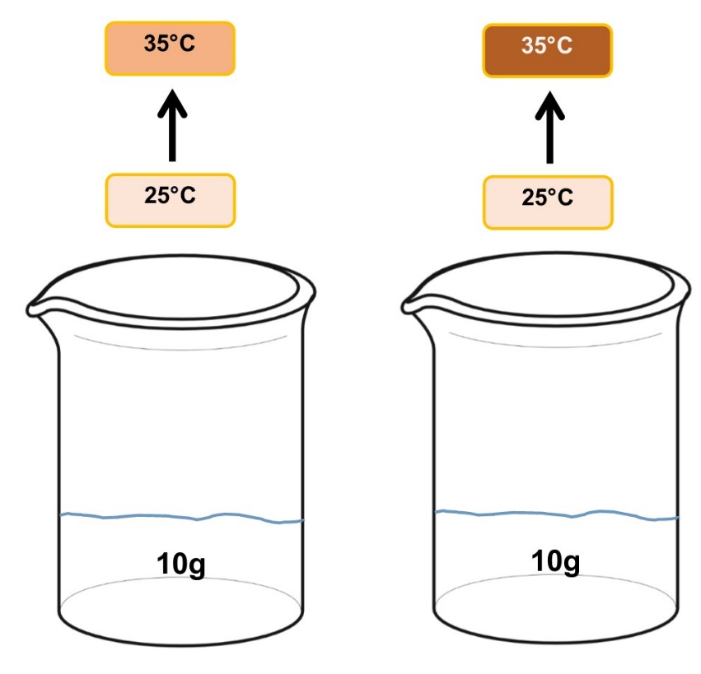
Change of Temperature
55 ℃
Given equivalent masses, will different temperature changes require different heat energy to be applied?
HEAT depends on Change of Temperature

Slide 5
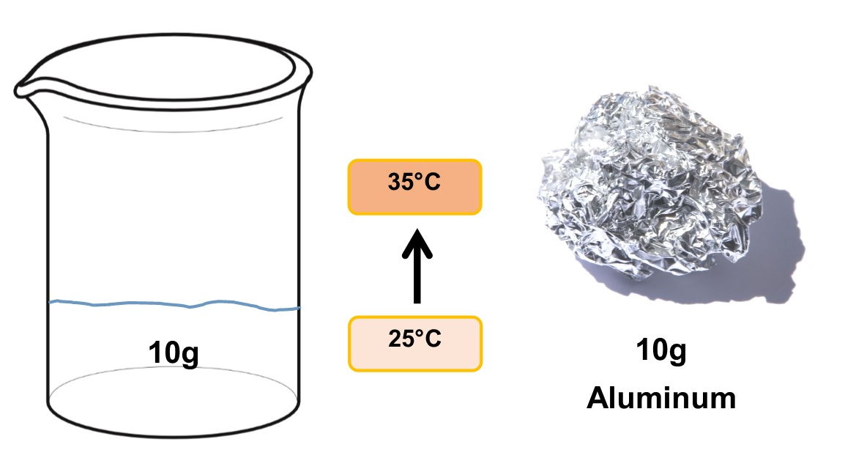
Type of Material
Will change in
temperature require
different amounts of heat energy for different materials?
NOTE: Every material has a defined specific heat. (calorie/g-ºC)
HEAT depends on Specific Heat of Material (type of material)

Slide 6
Heat Equation development
HEAT (calories or Joules) is dependent on:
Material Mass;
Change in Temperature; and
Type of Material (specific heat of a material)

Slide 7
HEAT = Material Mass x Change in Temperature x Specific Heat
Example: Calculate the heat transferred in Heat Transfer Experiment
(Hot A cup to Cold B cup)
        57g (mass) (about 2 ounces in B cup)
        3ºC (change in temperature)
        1 calorie/g-ºC (specific heat)
HEAT TRANSFERRED = 57g x 3ºC x 1 calorie/g-ºC = 171 calories

Slide 8
Temperature Differences Change Hurricane Strength
What happens to hurricane strength when it crosses warm water?
    Picks up heat energy from the water
    This happens because there is a temperature difference (warmer water, colder air in higher-altitude hurricane)
What happens to Hurricane Strength when it goes over land?
      Loses Energy (from cooler, drier air, and friction)

Slide 9
Hurricane Matthew Energy, 2016
What happened to the strength of Matthew when in the Carribean?
ANSWER: It gained strength over warm water.
What happened as Matthew moved north to Florida?
ANSWER: It decreased strength as waters got cooler.
What happened to the strength when Matthew hit land in SC?
ANSWER: It lost strength (down to a category 1).
CAT 1 LAND
CAT 3
CAT 4
START
CAT 5

Slide 10
Climate Change Impact: Storms
If Climate Change makes the ocean warmer, the temperature will rise.
The warmer water will have more Heat Energy.
What happens if there is a larger temperature difference between warmer oceans and cool air?
    Stronger storms are expected

Slide 11
Thank you for participating in the
CERT Educational Series
Heat Transfer Enrichment II:
Heat Equation, Weather Impacts

